Slide 1
Human Resource Management System
www.collaberadigital.com

Slide 2
Key Takeaways/Learnings from the Program (HTD)
Understanding the fundamentals of ASP.NET MVC Core:
We learn how to build web applications using the MVC (Model-View-Controller) design pattern, which helps separate the application's concerns and improve maintainability. They will also learn about key features such as routing, middleware, dependency injection, and Razor views.
Back-end development: We learned about back-end web development using technologies such as Entity Framework Core, SQL Server, and Web API.
Building responsive user interfaces:
We learned about frameworks like Bootstrap, which provide pre-built UI components that can be used to create responsive designs quickly.
Deployment and hosting: We learned how to deploy and web applications using Docker Desktop.
Communication and Project Management: SDLC and Github

Slide 3




Problem Statement of the Capstone Project
Employee Data

Slide 4
Problem Statement of the Capstone Project
How does a manual process of storing data in the Human Resource Department hinder its operations and effectiveness?
Based on the current challenges and goals of the Human Resource Department, what are the potential costs and benefits of investing in an HR management system (HRMS), and what factors should be considered before making a decision?

Slide 5
Problem Statement of the Capstone Project
Slow process of their Human Resource
Difficulty in monitoring their records
Slow retrieval of data
Paper Wastage
Poor Data Storage
Unsecured data

Slide 6
Approach Note
(How the candidate approached the program)
Identify the goals and objectives of the HR system
Define the system requirements
Choose the right technology
Design the user interface
Develop and test the system
Deploy the system
Maintain and support the system

Slide 7
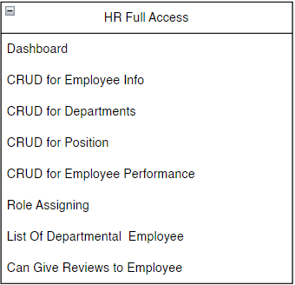
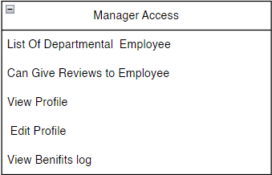
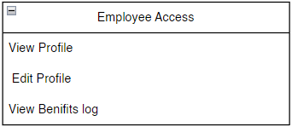
Access

Slide 8
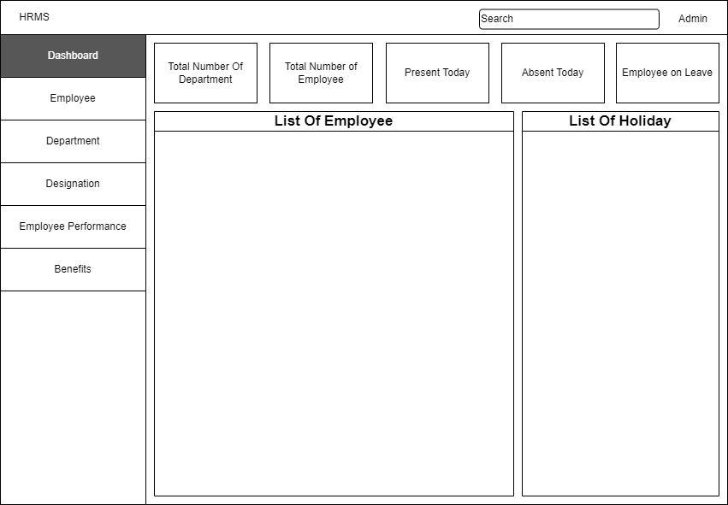
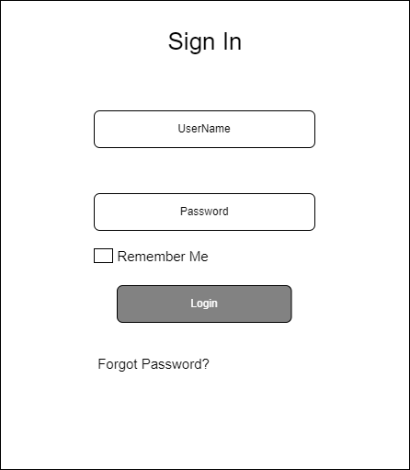
Wireframe/Architecture

Slide 9
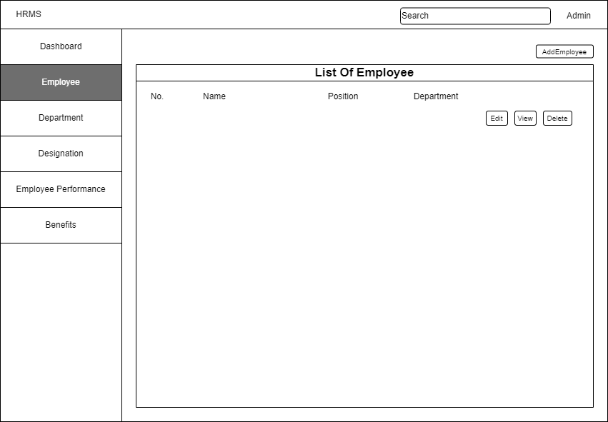
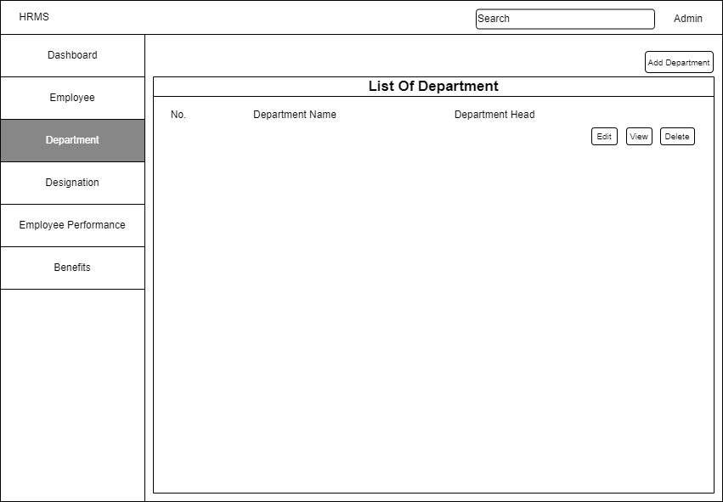
Wireframe/Architecture

Slide 10
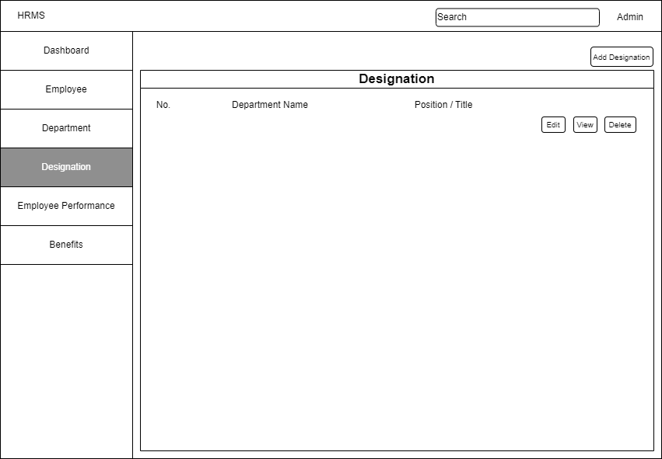
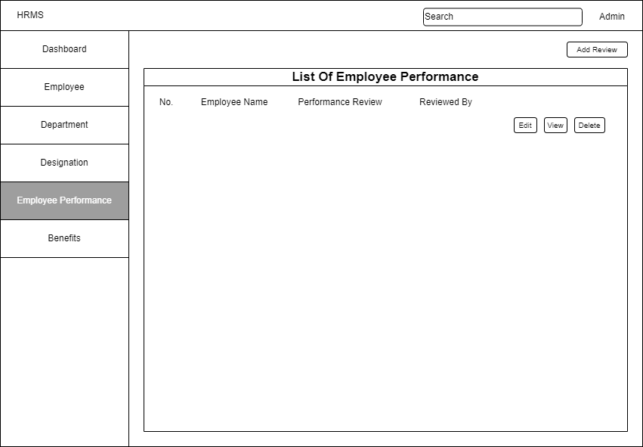
Wireframe/Architecture

Slide 11

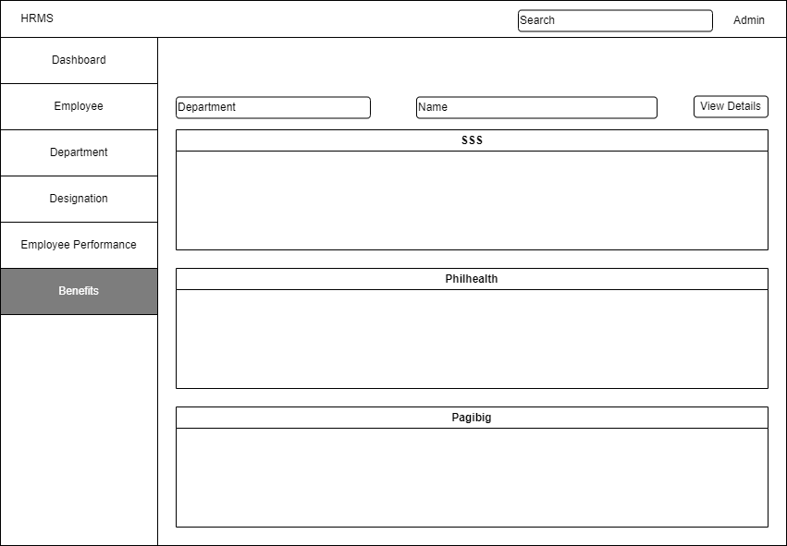

Wireframe/Architecture
www.collaberadigital.com

Slide 12
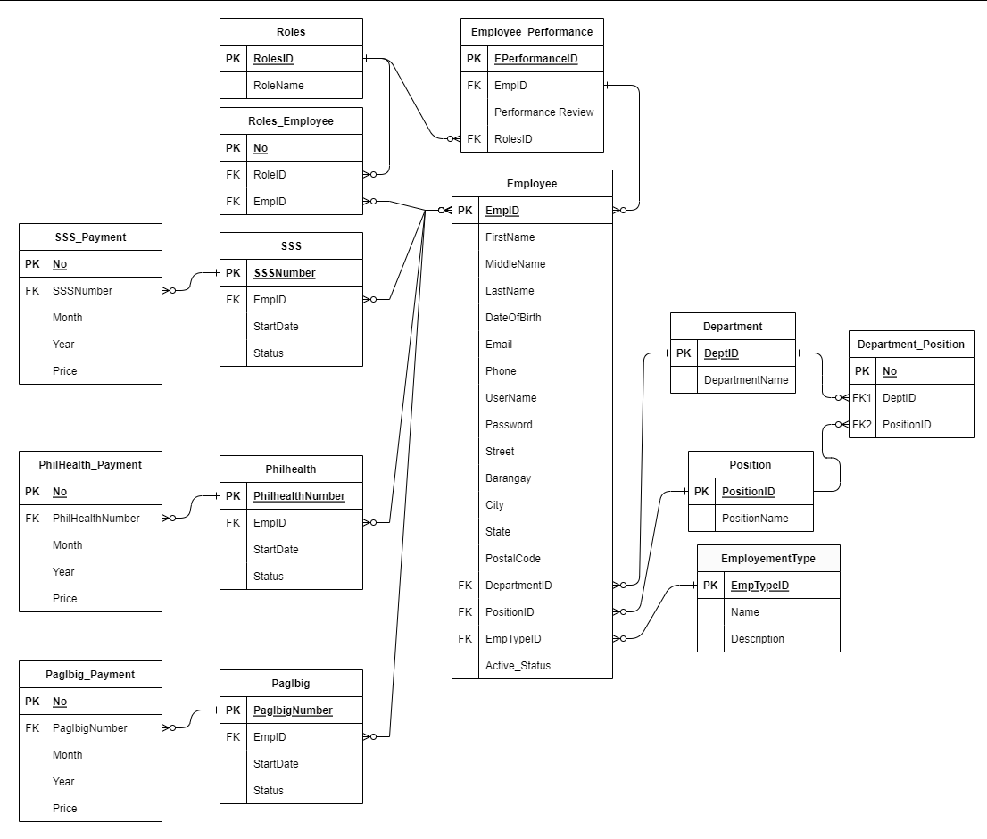
Important areas of the Project with screenshots
(Frontend, Database, Backend, Key Validations, Functionalities Etc.)
www.collaberadigital.com

Slide 13
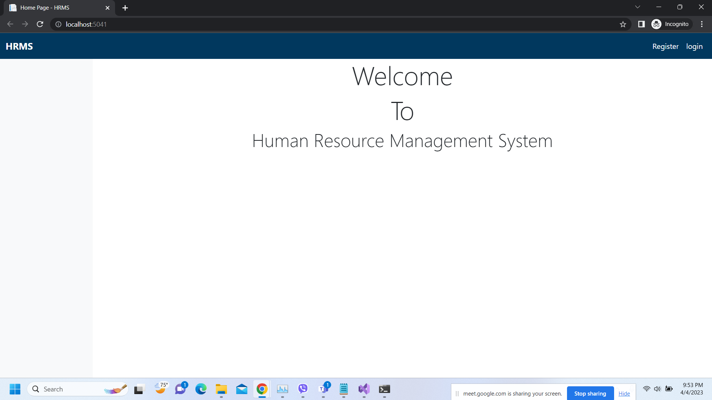
Important areas of the Project with screenshots
(Frontend, Database, Backend, Key Validations, Functionalities Etc.)
Home Page

Slide 14
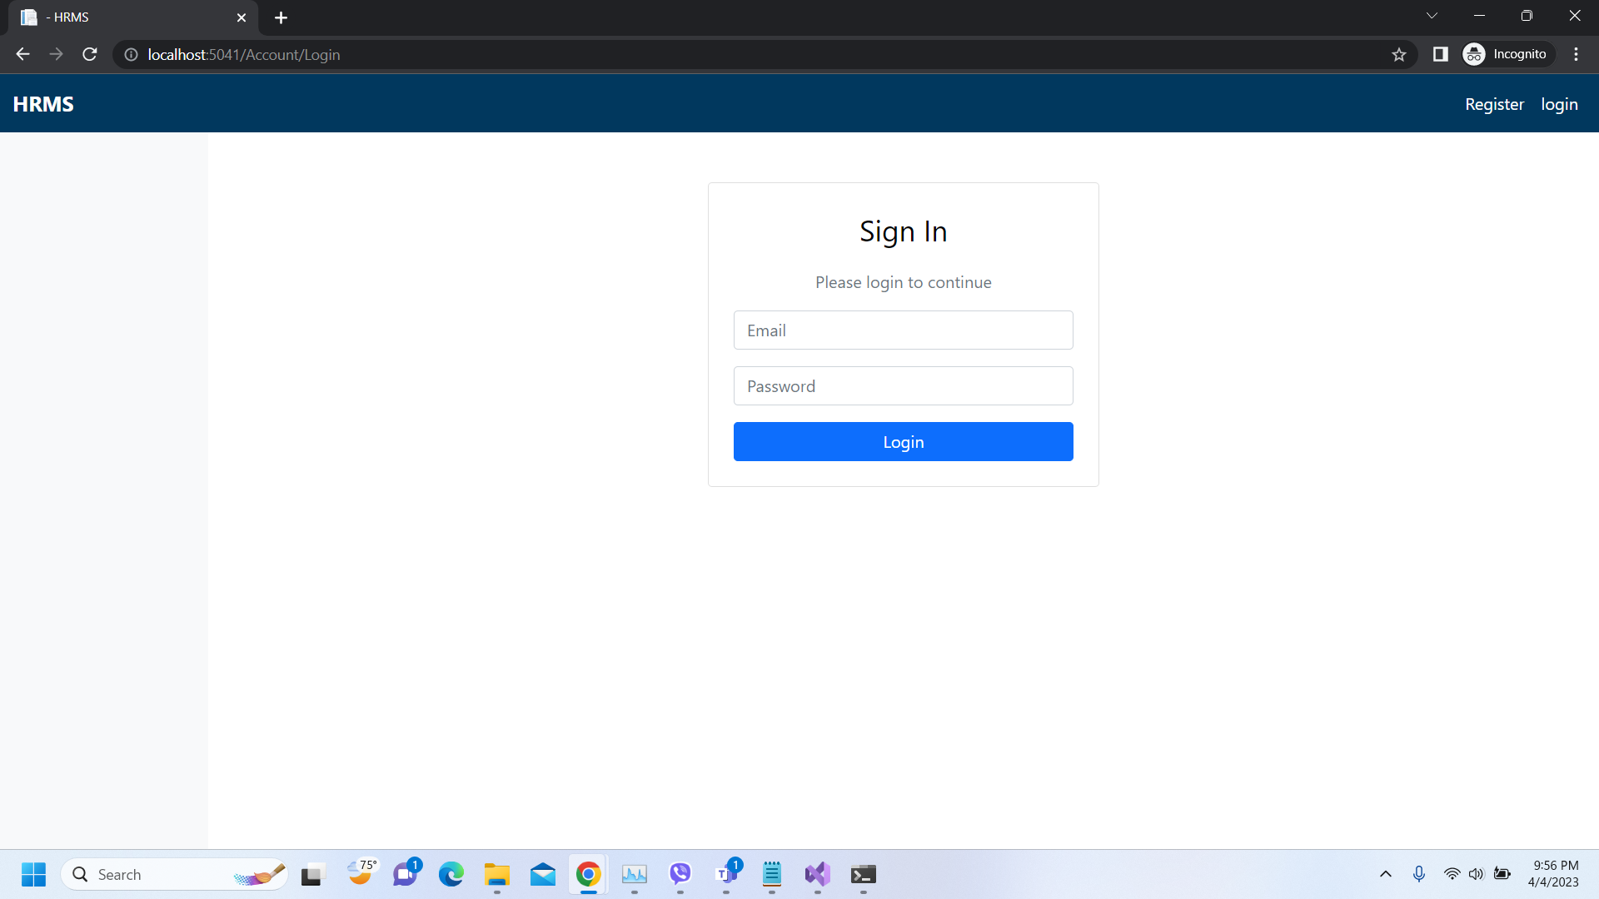
Important areas of the Project with screenshots
(Frontend, Database, Backend, Key Validations, Functionalities Etc.)
Login Page

Slide 15
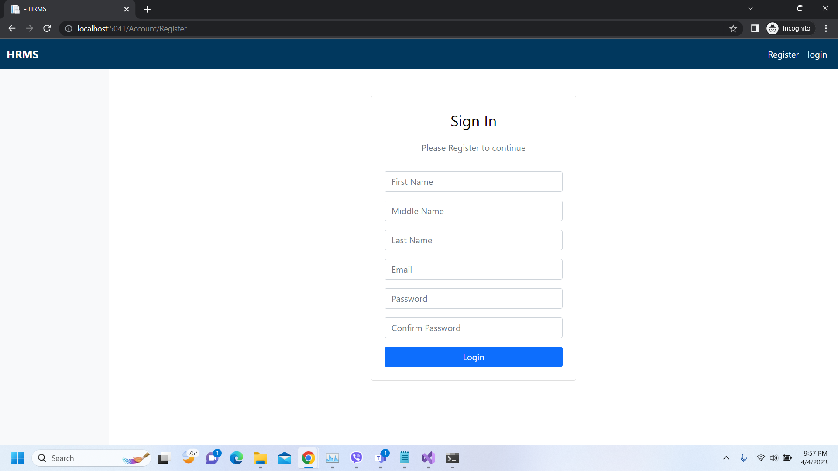
Important areas of the Project with screenshots
(Frontend, Database, Backend, Key Validations, Functionalities Etc.)
SignIn Page

Slide 16
Important areas of the Project with screenshots
(Frontend, Database, Backend, Key Validations, Functionalities Etc.)
Admin (HR) Access

Slide 17
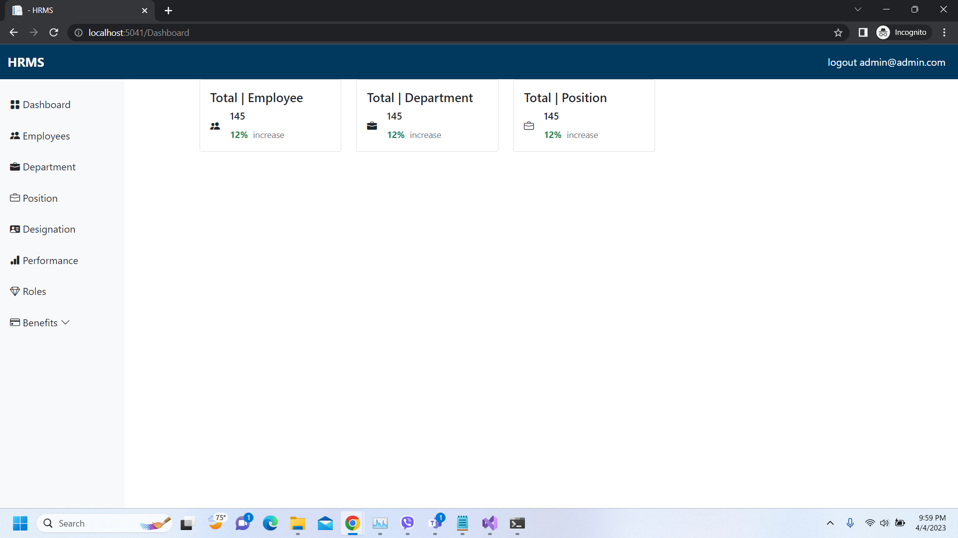
Important areas of the Project with screenshots
(Frontend, Database, Backend, Key Validations, Functionalities Etc.)
Dashboard

Slide 18
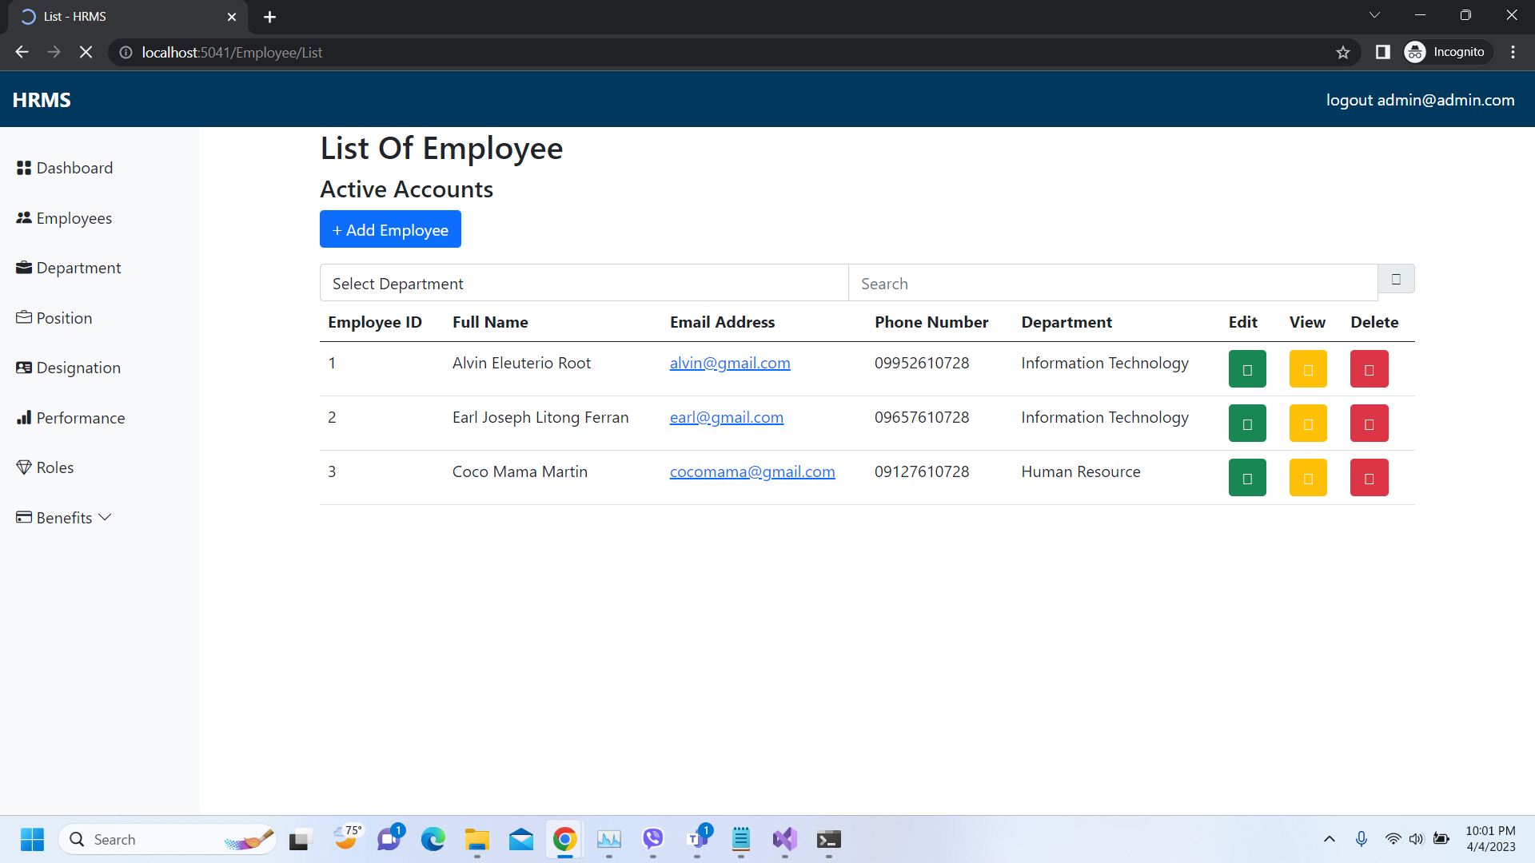
Important areas of the Project with screenshots
(Frontend, Database, Backend, Key Validations, Functionalities Etc.)
List Of Employee

Slide 19
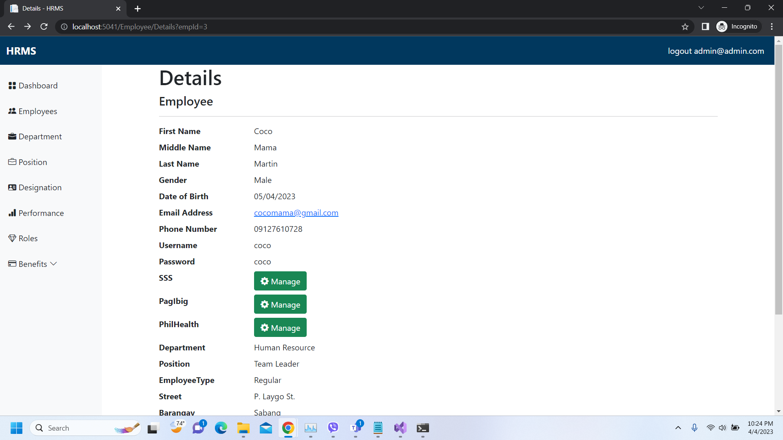
Important areas of the Project with screenshots
(Frontend, Database, Backend, Key Validations, Functionalities Etc.)
Details Of Employee

Slide 20
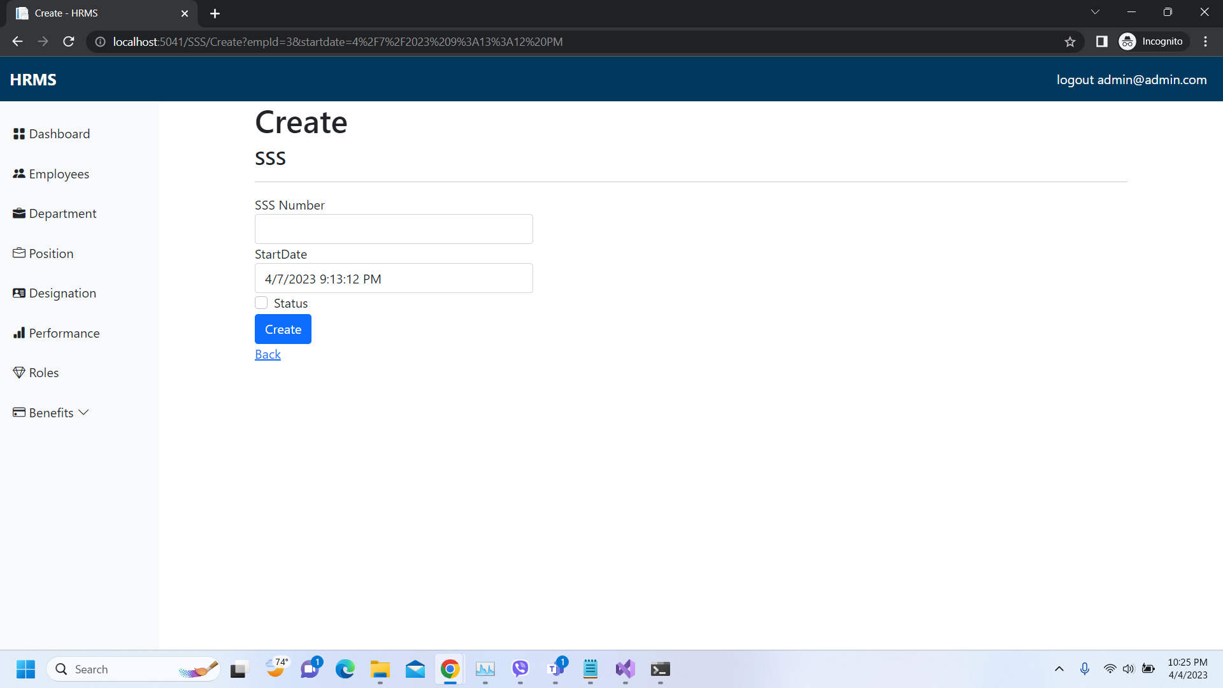
Important areas of the Project with screenshots
(Frontend, Database, Backend, Key Validations, Functionalities Etc.)
Add Benefit Details

Slide 21
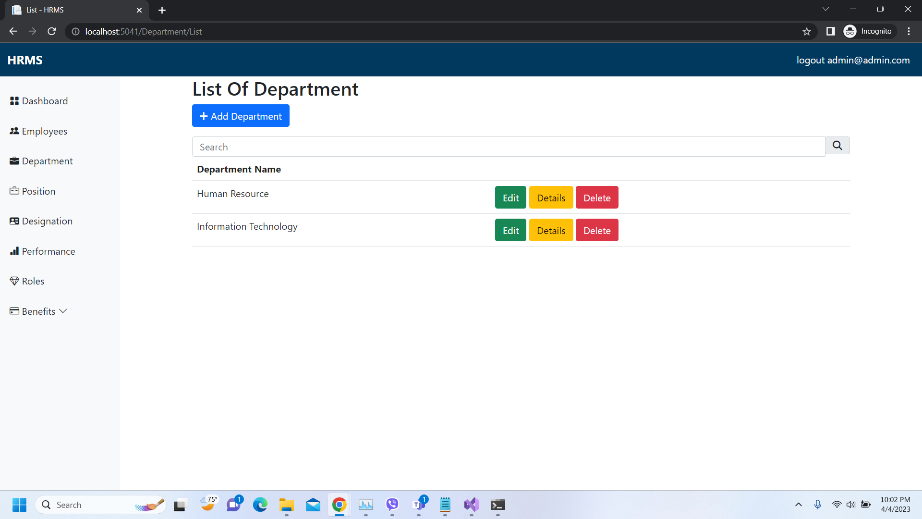
Important areas of the Project with screenshots
(Frontend, Database, Backend, Key Validations, Functionalities Etc.)
List Of Department

Slide 22
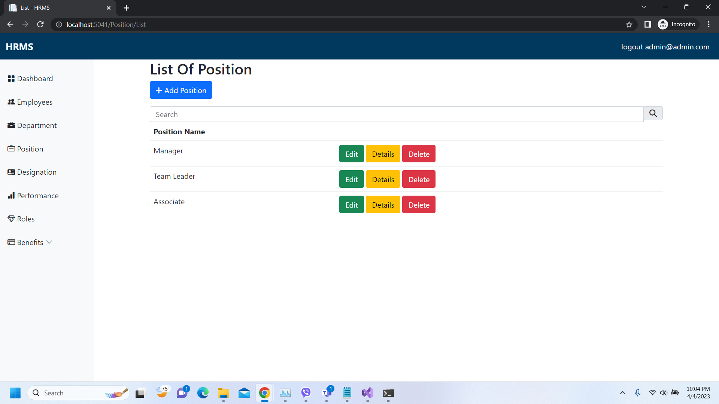
Important areas of the Project with screenshots
(Frontend, Database, Backend, Key Validations, Functionalities Etc.)
List Of Position

Slide 23
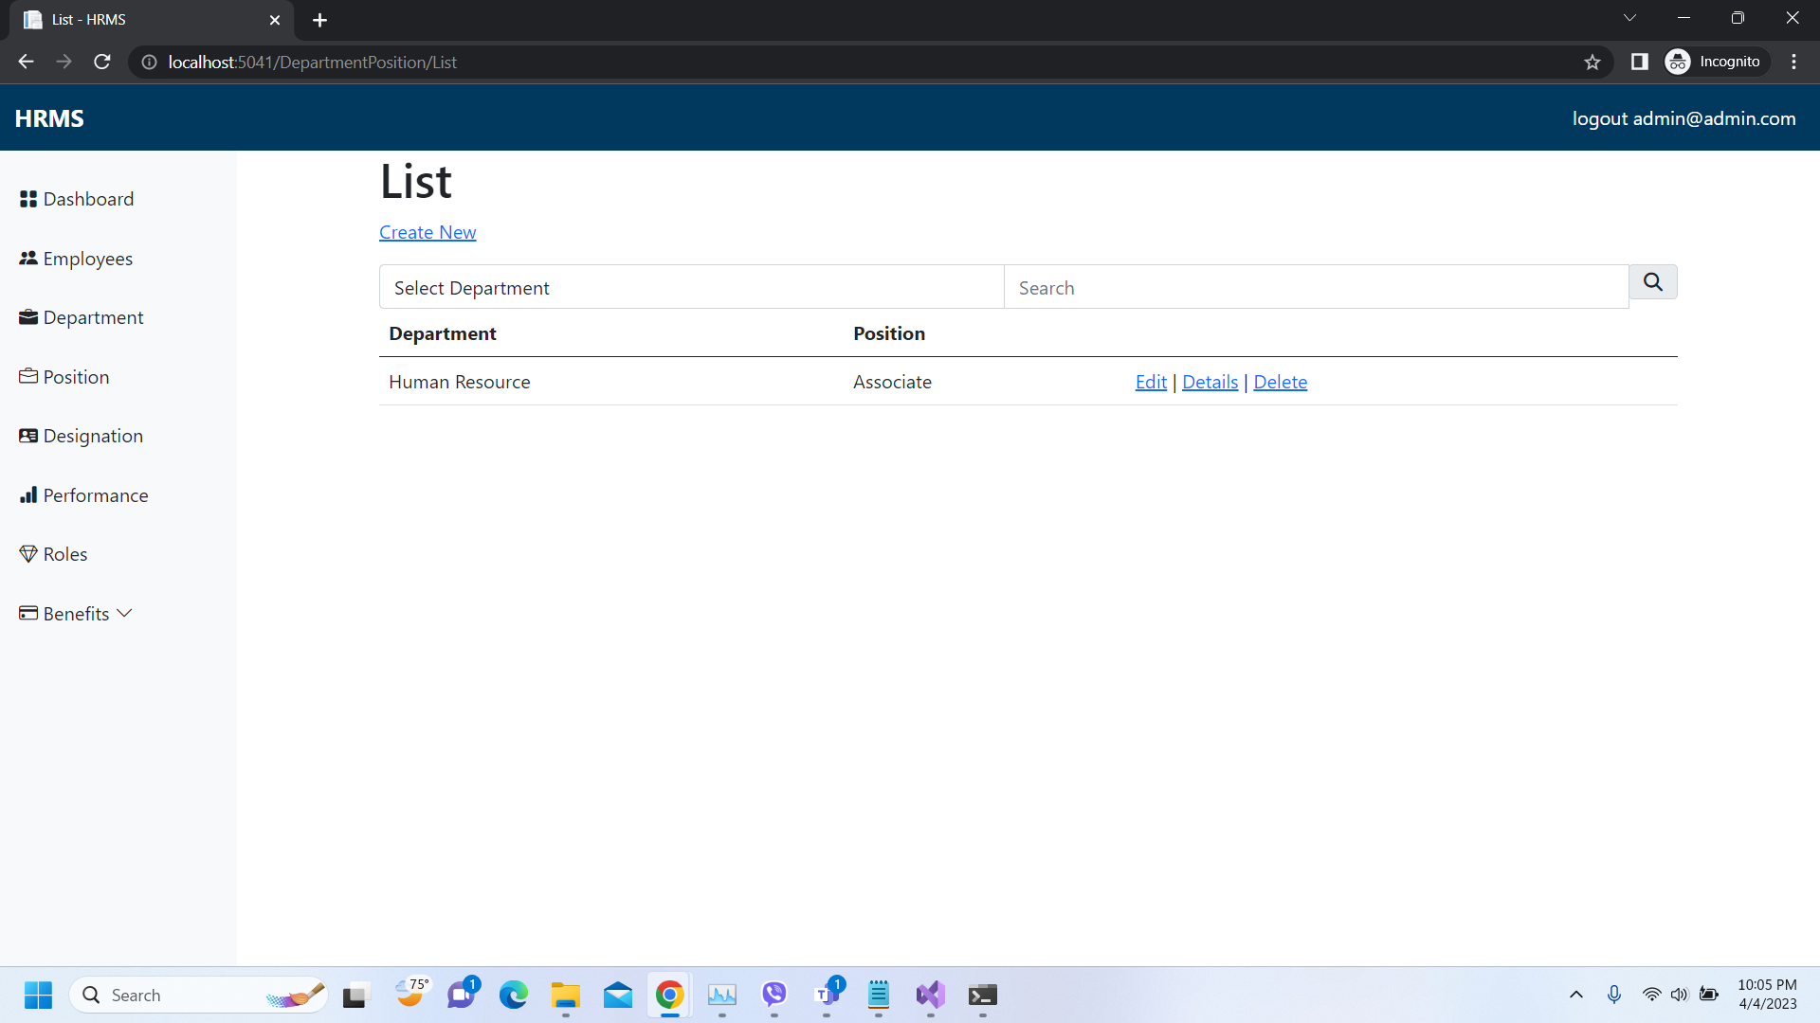
Important areas of the Project with screenshots
(Frontend, Database, Backend, Key Validations, Functionalities Etc.)
List Of Designation

Slide 24
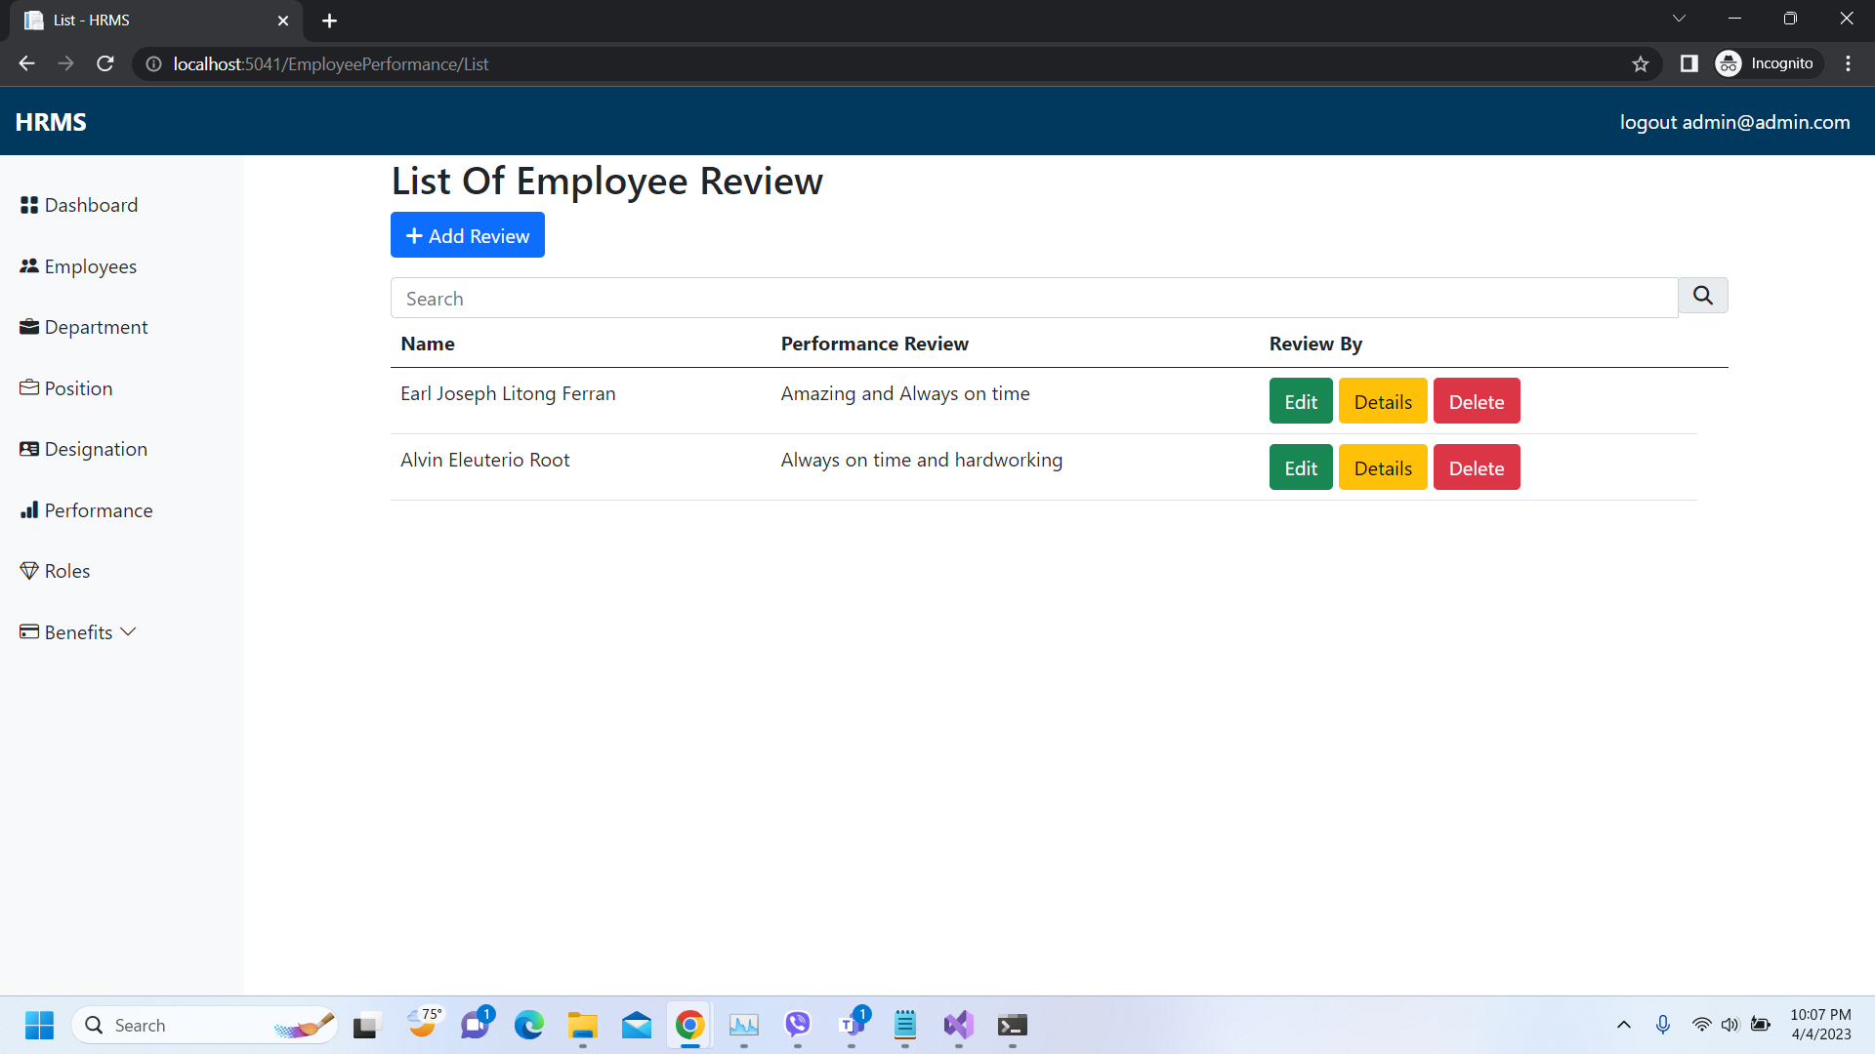
Important areas of the Project with screenshots
(Frontend, Database, Backend, Key Validations, Functionalities Etc.)
Employee Performance Review

Slide 25
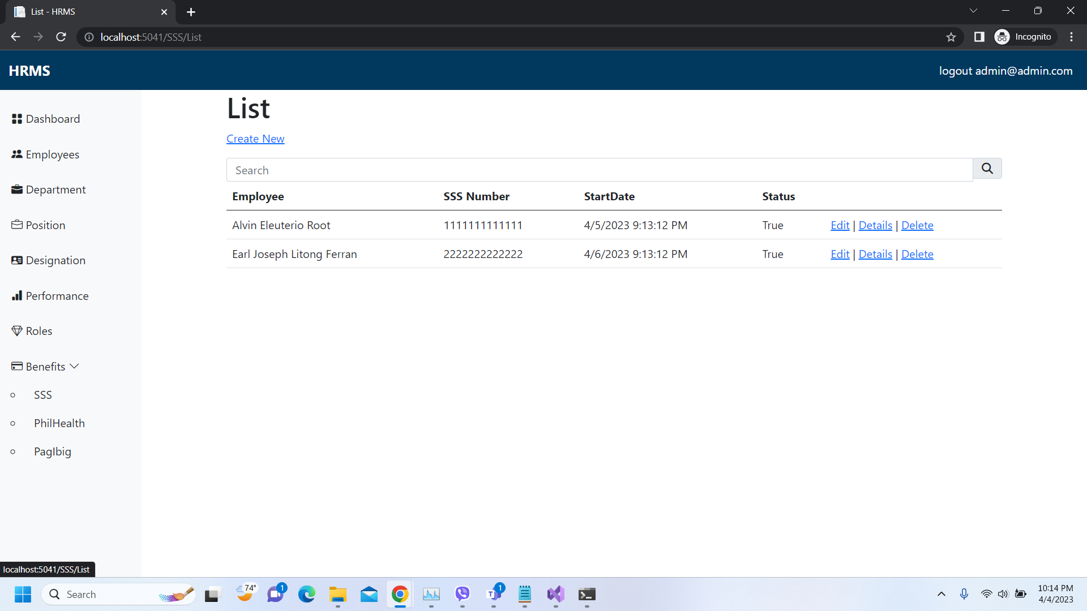
Important areas of the Project with screenshots
(Frontend, Database, Backend, Key Validations, Functionalities Etc.)
Benefits List (SSS)

Slide 26
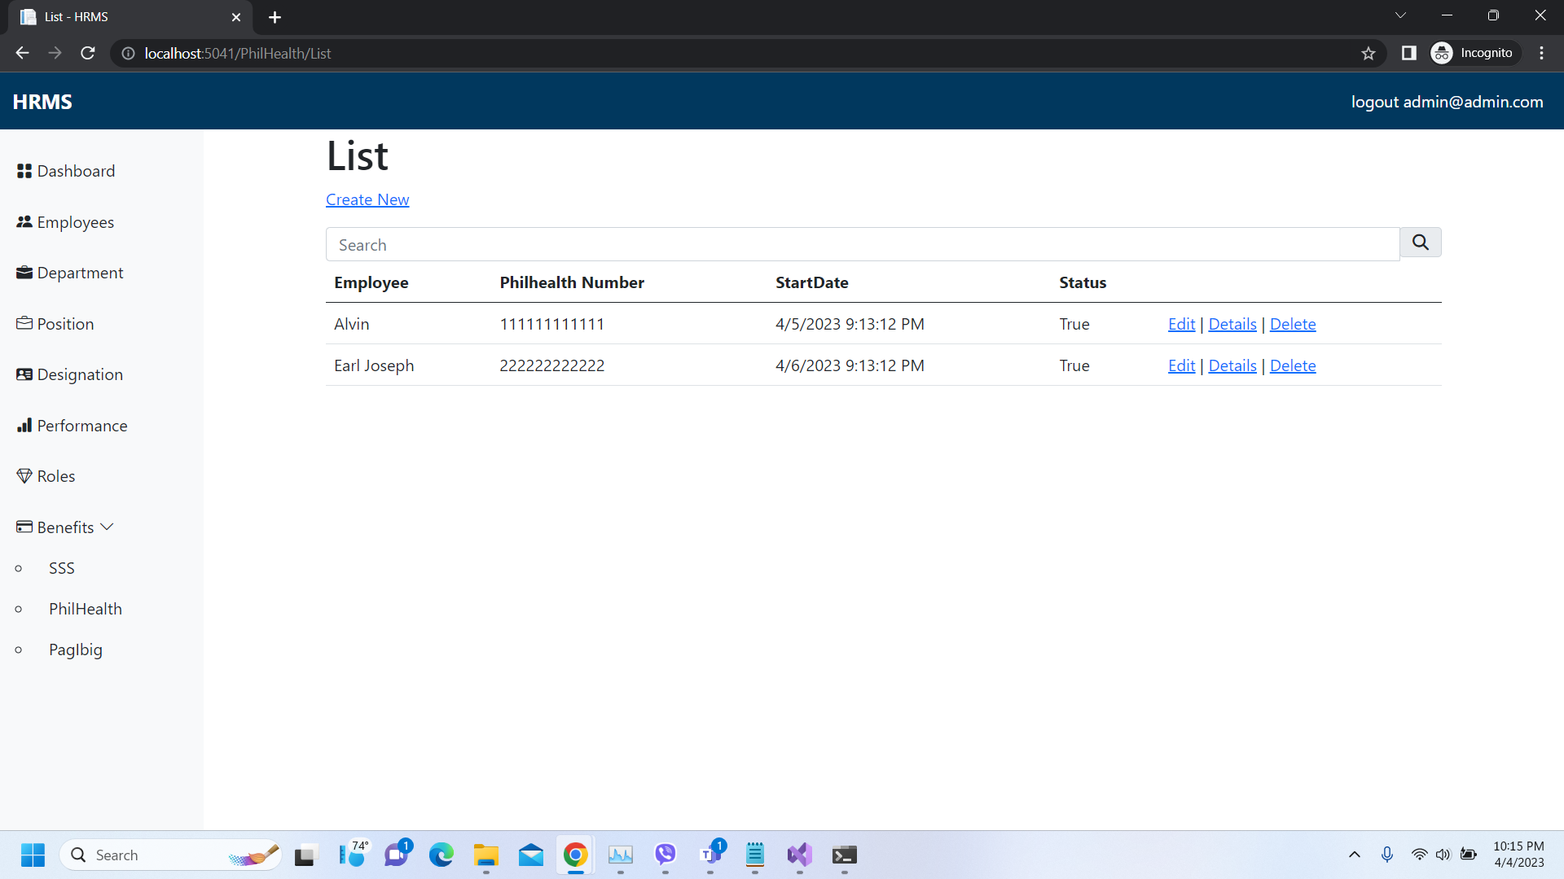
Important areas of the Project with screenshots
(Frontend, Database, Backend, Key Validations, Functionalities Etc.)
Benefits List (PhilHealth)

Slide 27
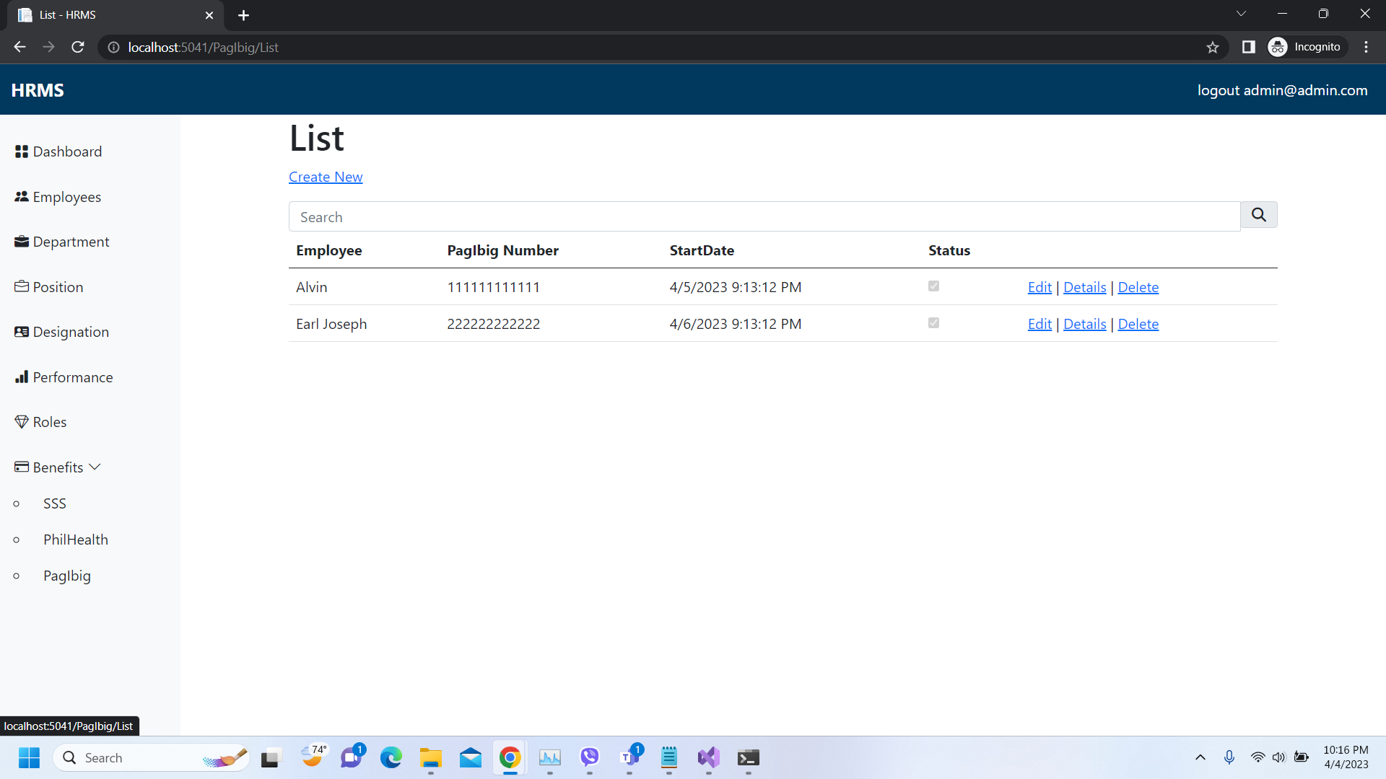
Important areas of the Project with screenshots
(Frontend, Database, Backend, Key Validations, Functionalities Etc.)
Benefits List (PagIbig)

Slide 28
Important areas of the Project with screenshots
(Frontend, Database, Backend, Key Validations, Functionalities Etc.)
Manager Access

Slide 29
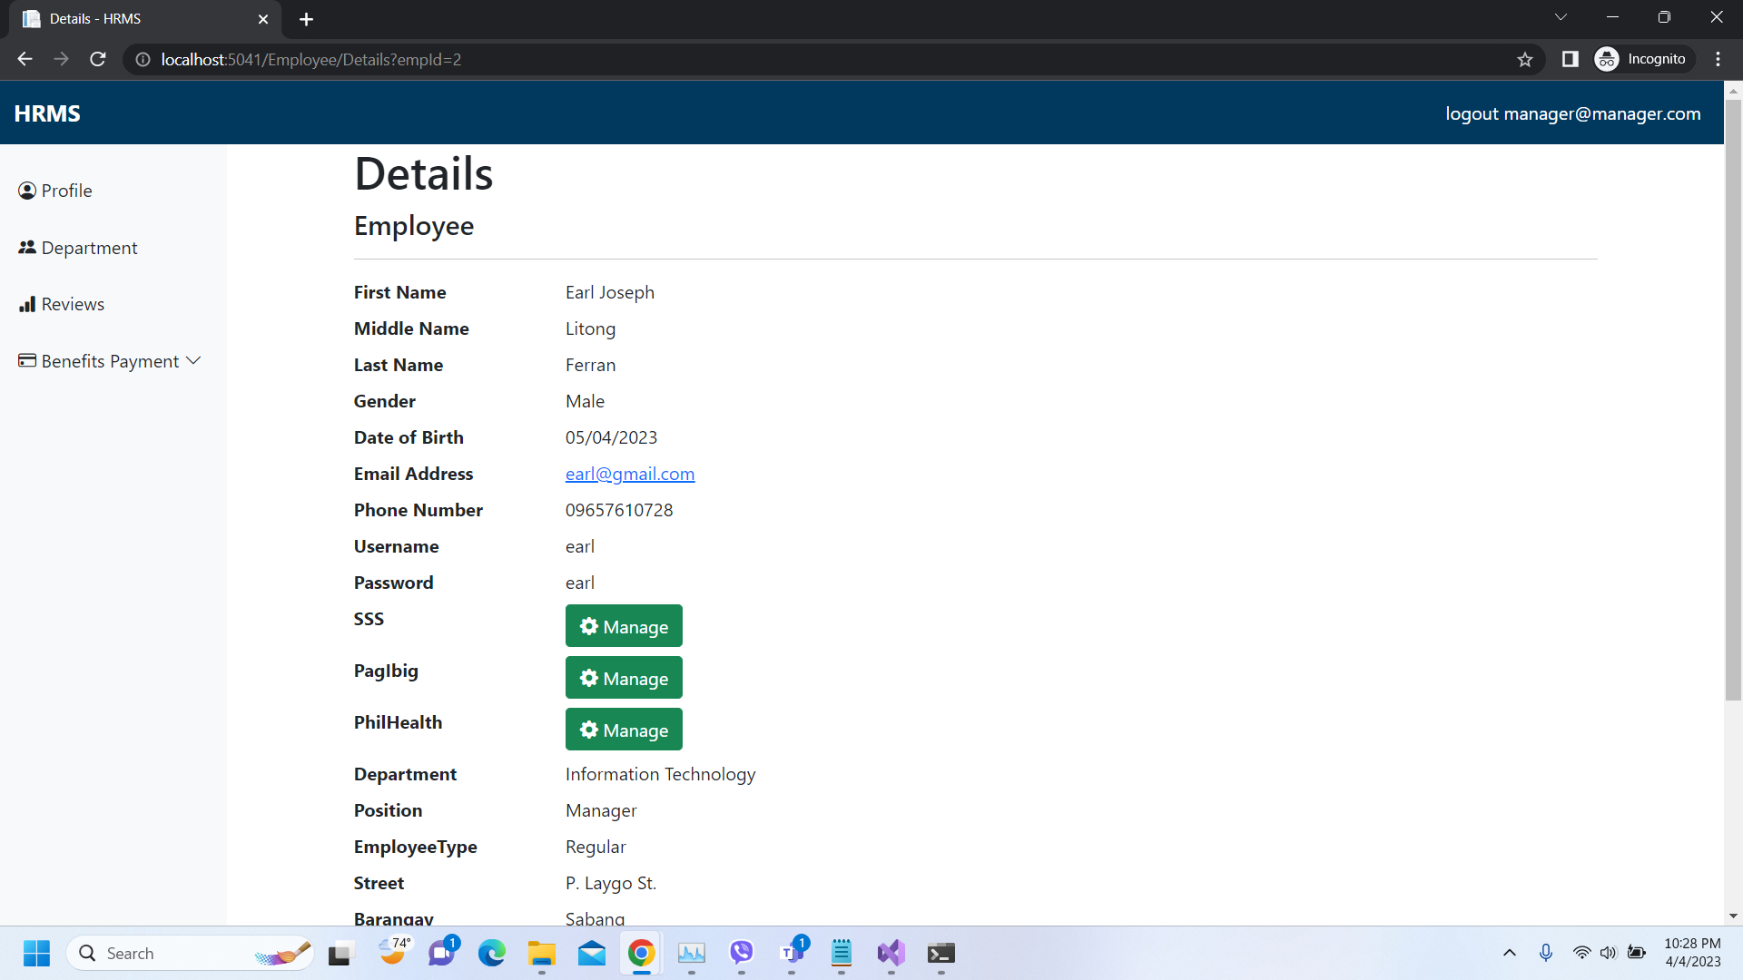
Important areas of the Project with screenshots
(Frontend, Database, Backend, Key Validations, Functionalities Etc.)
Profile (Details)

Slide 30
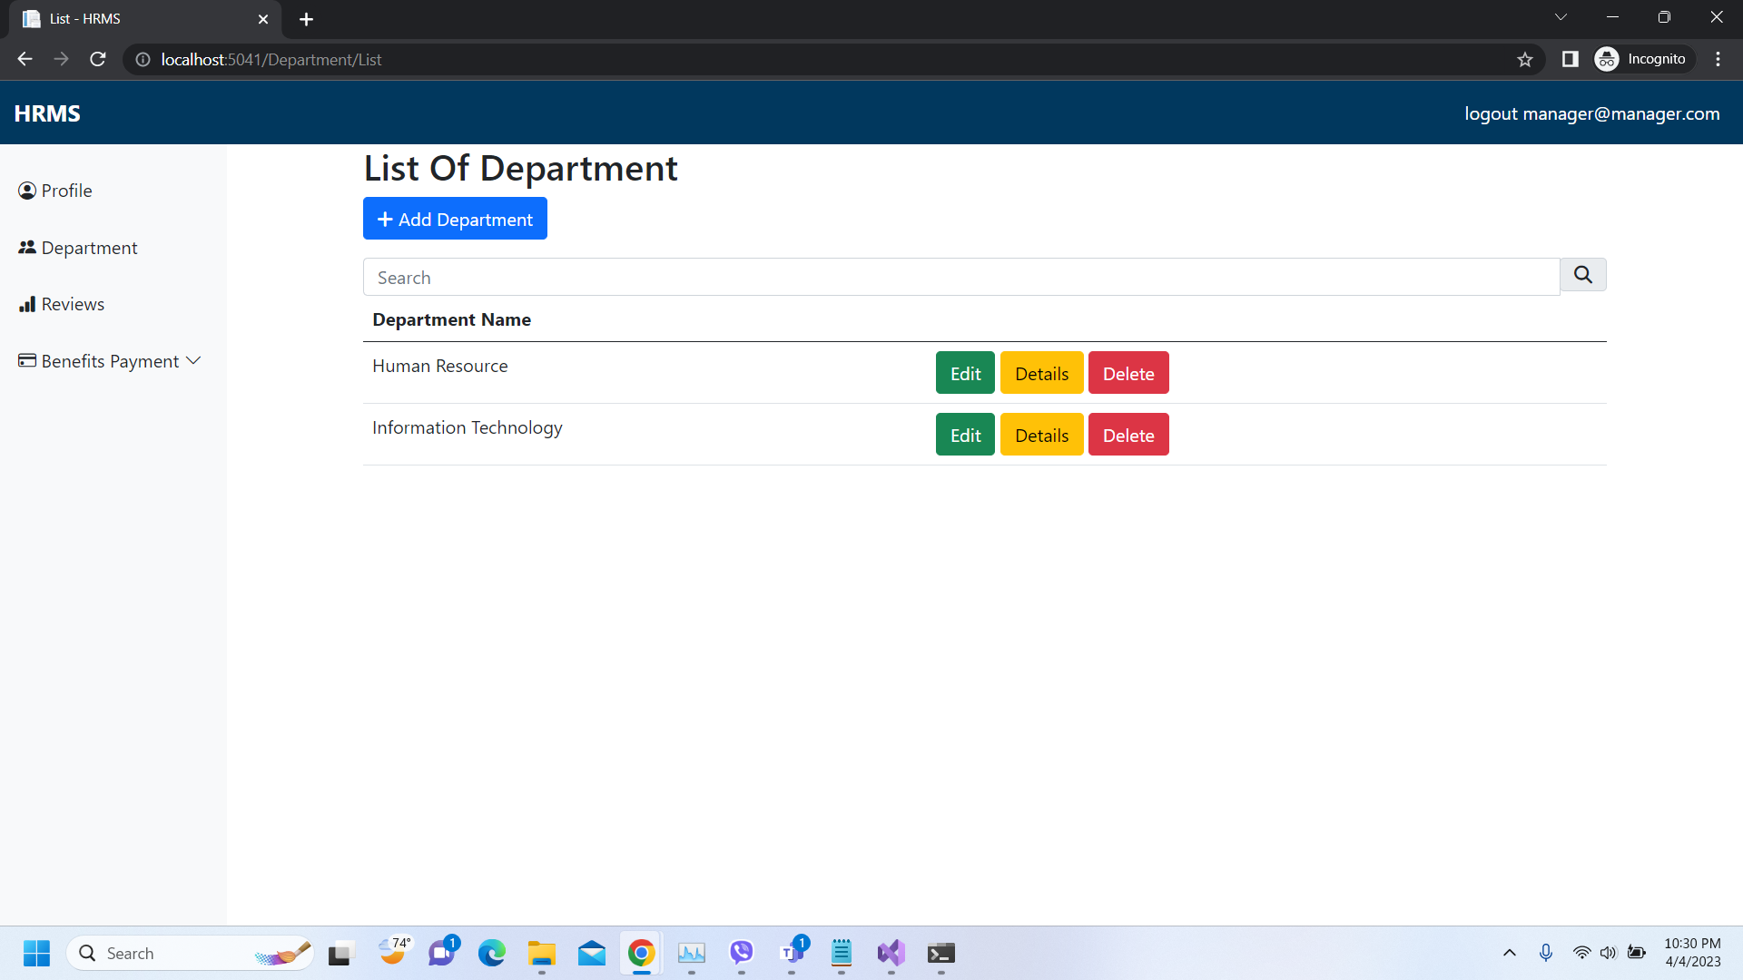
Important areas of the Project with screenshots
(Frontend, Database, Backend, Key Validations, Functionalities Etc.)
List of Department

Slide 31
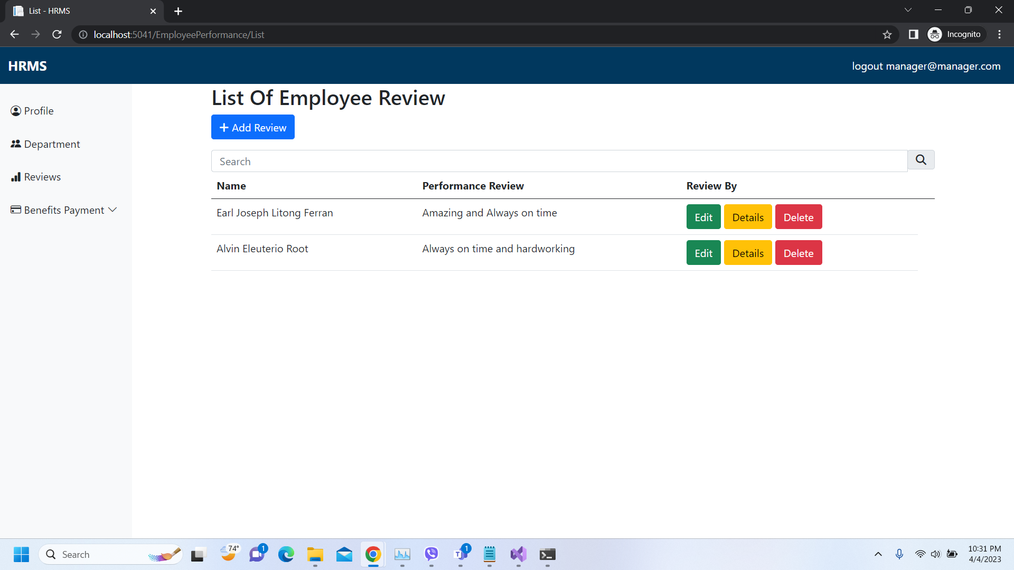
Important areas of the Project with screenshots
(Frontend, Database, Backend, Key Validations, Functionalities Etc.)
List of Employee Performance

Slide 32
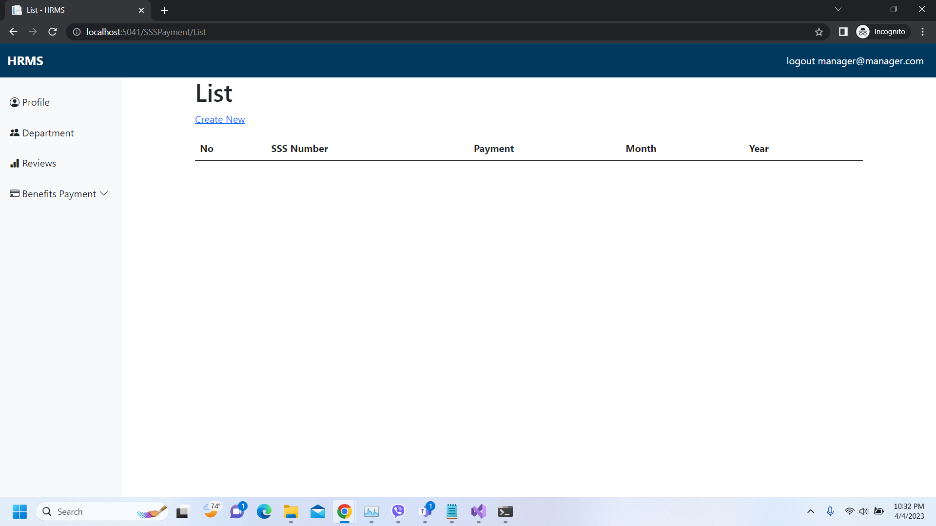
Important areas of the Project with screenshots
(Frontend, Database, Backend, Key Validations, Functionalities Etc.)
Profile (Details)

Slide 33
Important areas of the Project with screenshots
(Frontend, Database, Backend, Key Validations, Functionalities Etc.)
User (Employee) Access

Slide 34
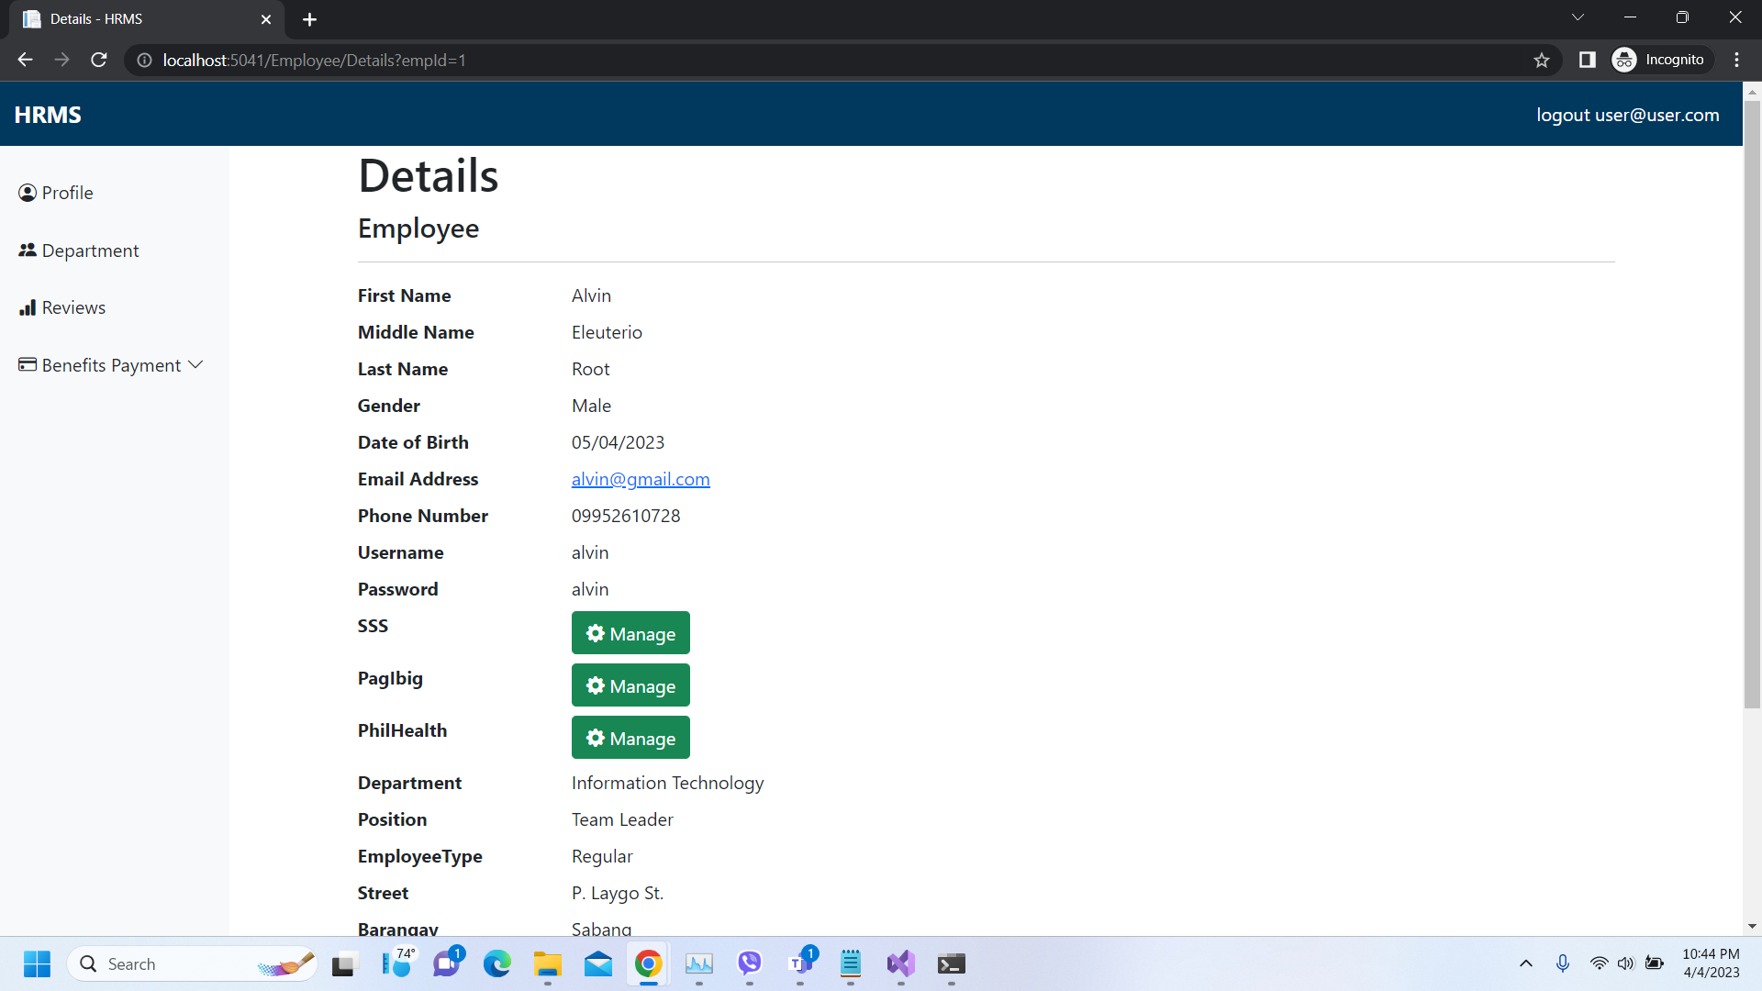
Important areas of the Project with screenshots
(Frontend, Database, Backend, Key Validations, Functionalities Etc.)
List of Benefits Payment

Slide 35

Important areas of the Project with screenshots
(Frontend, Database, Backend, Key Validations, Functionalities Etc.)
Department Assigned

Slide 36
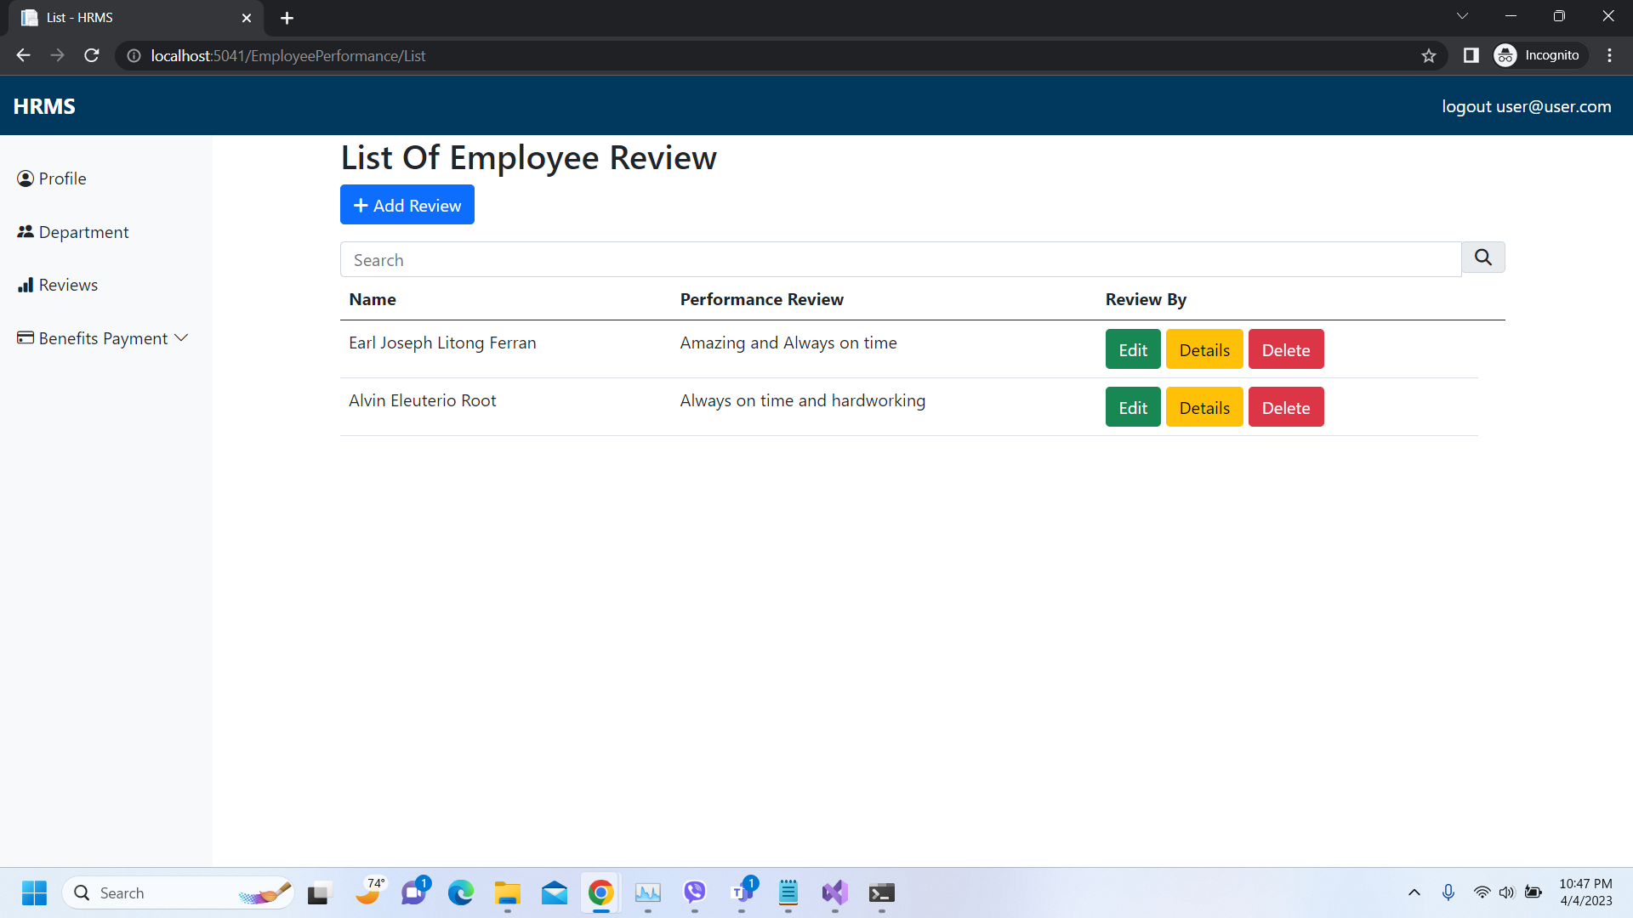
Important areas of the Project with screenshots
(Frontend, Database, Backend, Key Validations, Functionalities Etc.)
Performance Review

Slide 37
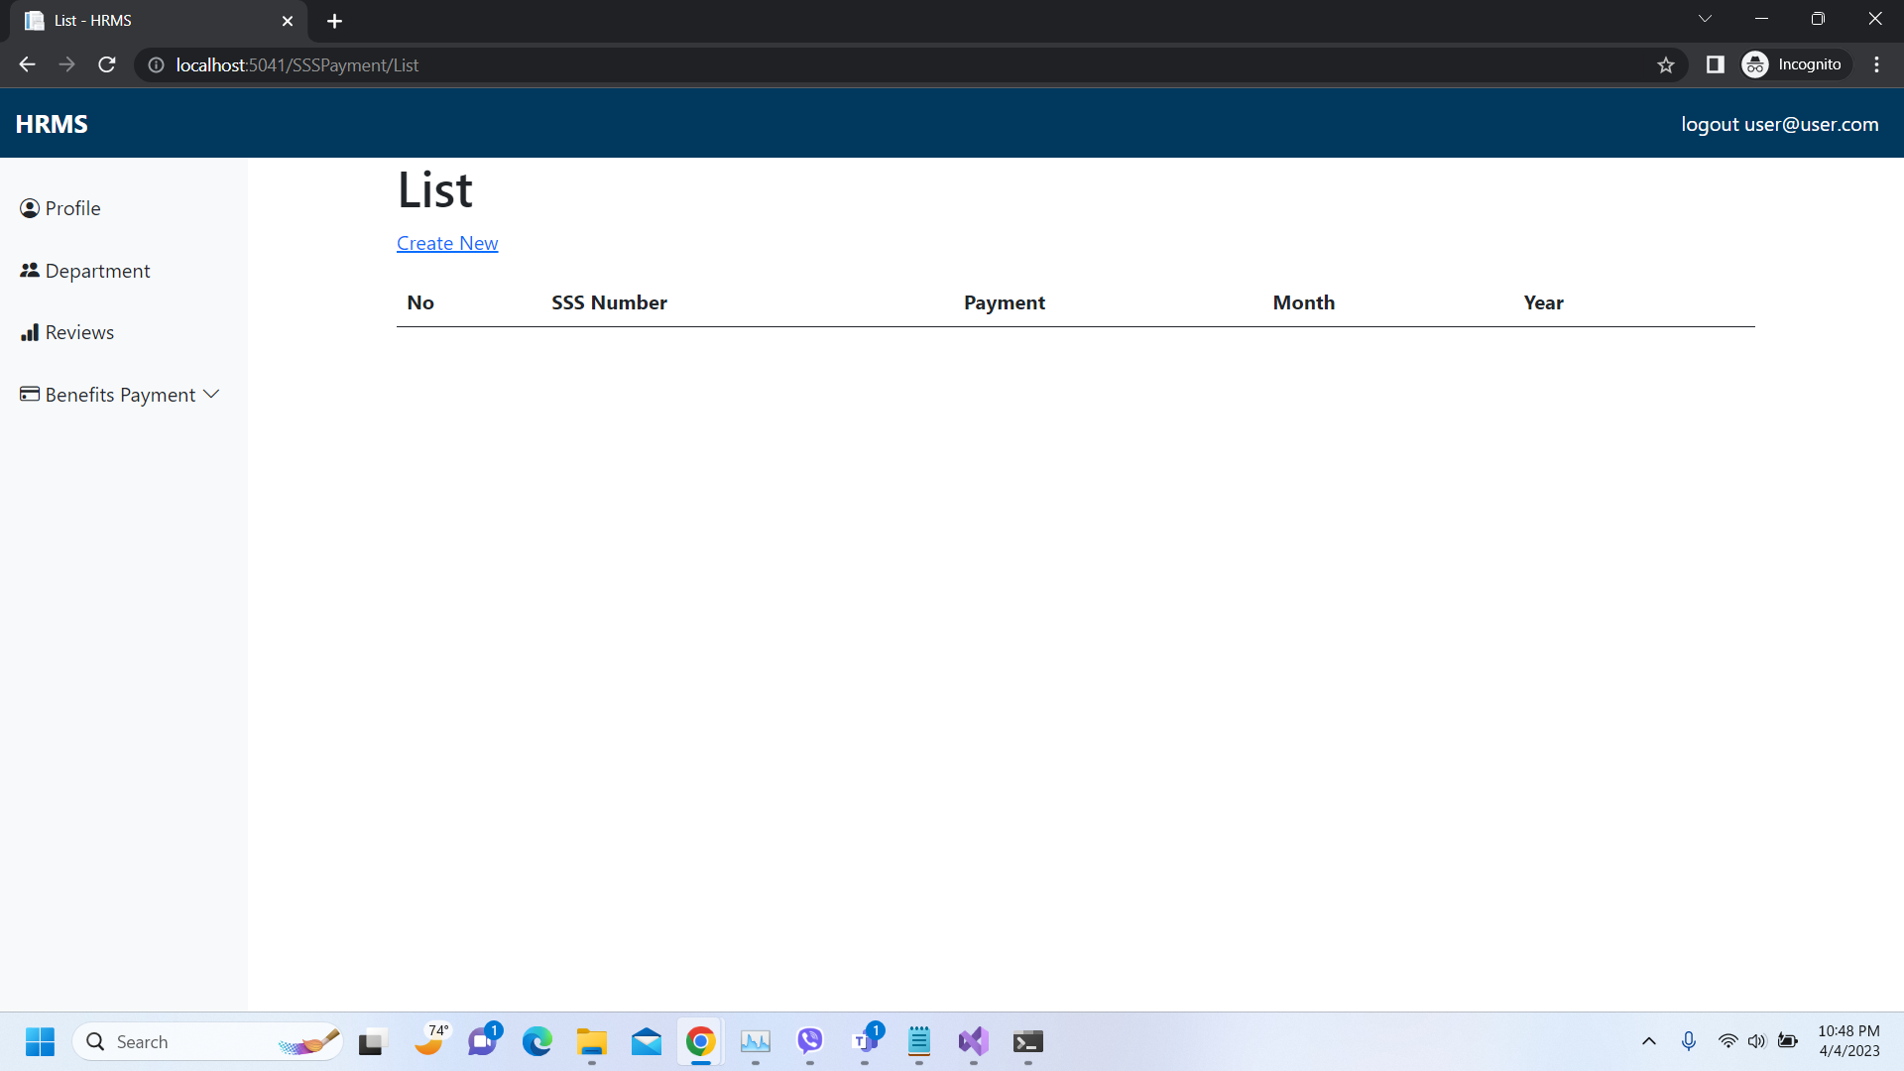
Important areas of the Project with screenshots
(Frontend, Database, Backend, Key Validations, Functionalities Etc.)
Benefits Payment

Slide 38
Conclusion
An automated HR management system can address challenges posed by manual HR management processes, such as errors, limited accessibility, lack of automation, and compliance risks.
Defining the scope and requirements of the HR management system can improve compliance with employment laws and regulations, and ultimately enhance the efficiency of HR operations.
Investing in an automated HR management system is a worthwhile investment that can yield significant benefits for any organization relying on effective HR management practices.

Slide 39
Thank You
www.collaberadigital.com

Slide 40
Personal BACKGROUND
(Name, Past Experience, Qualification, Career Summary)
Name : Earl Joseph L. Ferran
Past Experience : Programmer
Qualification : Bachelor Of Science in Computer Engineering
Career Summary : I am a programmer with 9 months work experience in self-learning and practice, with a focus on IOT programming. In my most recent role, I developed two IOT-based systems - a Water Quality Management System for fish pond and a Student Temperature Monitoring System - which allowed me to gain valuable real-world experience and hone my programming skills in the field of IOT.

Slide 41
Personal BACKGROUND
(Name, Past Experience, Qualification, Career Summary)
Name : Alvin E. Root
Past Experience : Video Editing (Work Experience)
Qualification : Bachelor of Science in Computer Science
Career Summary : I earned a Bachelor of Science degree in Computer Science from Kolehiyo ng Lungsod ng Lipa, and have gained nearly four years of valuable experience working as a Video Editor. However, after careful consideration and recognizing my deep-seated passion for the field, I have recently decided to return to my roots in computer science. My goal is to build a career in this exciting and ever-evolving field once again. During my time as an intern, I had the opportunity to develop a desktop application called Network Based Student Information System, using VB.Net and SQL Server.

